Slide 1
а
French and Polish partners of Mariupol city

Slide 2


Mariupol- Safe
TRUST
ІННОВАЦІЇ
The highest level of trust to the police among all Ukrainian cities
INNOVATIONS
SAFETY
UASC
United Analytical Service Center
5th place in the rating of the safest cities of Ukraine
‘Safe city’ special purpose program
ORDER
60% less offenses in 2017
2

Slide 3


Mariupol- Transparent
ProZorro. Sale
Achievements
ІННОВАЦІЇ
United Call Center
The first place in the rating of the most transparent cities of Ukraine by the version of Transparency international
Fifth among the leaders in terms of satisfaction with the services among major cities of Ukraine
Open budget
DoZorro
ProZorro
System of local petitions
ALDA
Social inspector
EUACI
83% is a level of trust to Mariupol City Mayor
3

Slide 4
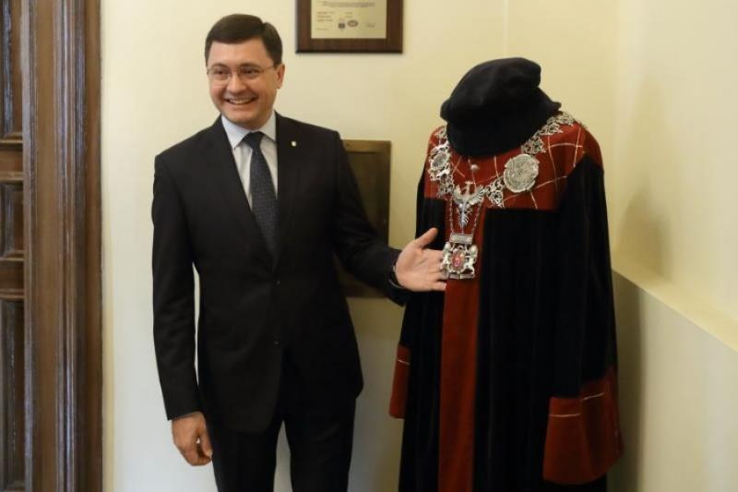
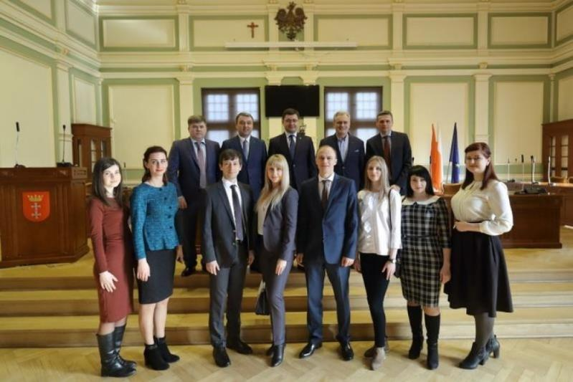
Visit of Gdansk
12.12.2014 Signing of the intentions of cooperation between Gdansk municipality of the Republic of Poland and Mariupol, Ukraine with an indefinite period of validity
09.12.2017 With the support of Gdansk , the office of the Local Democracy Agency - LDA-Mariupol - was opened in Mariupol
In order to study the experience of European colleagues from the management of the housing stock to attracting international investment in 2018, a delegation from Mariupol, headed by Mayor Vadim Boichenko, met with the Mayor of Gdansk, his deputies and the chairman of the City Council
4

Slide 5
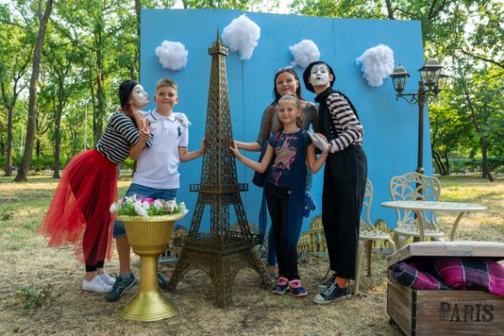
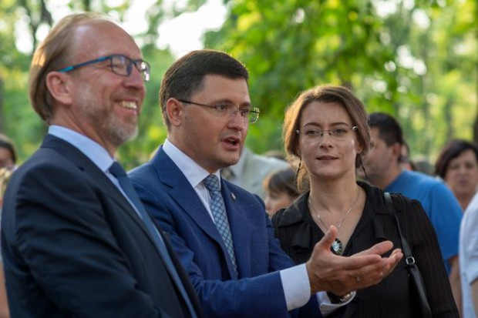
The Day of France in Mariupol
07/11/2018 The day of France was held for the first time in Mariupol, this day is dedicated to celebrate the National Holiday of France - Bastille Day
Many thematic locations and a photozone recreated the atmosphere of the European capital
Mariupol was visited by Ambassador of France Isabel Dumont. The charming guest danced and sang in the park and the residents listened to music at the Chamber Philharmonic, they had rest in the City Garden, plunged into the history of French culture and art, rode a horse carriage and created the Eiffel Tower
5

Slide 6
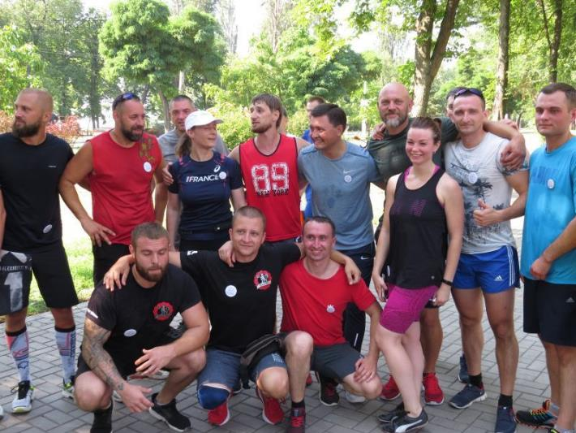
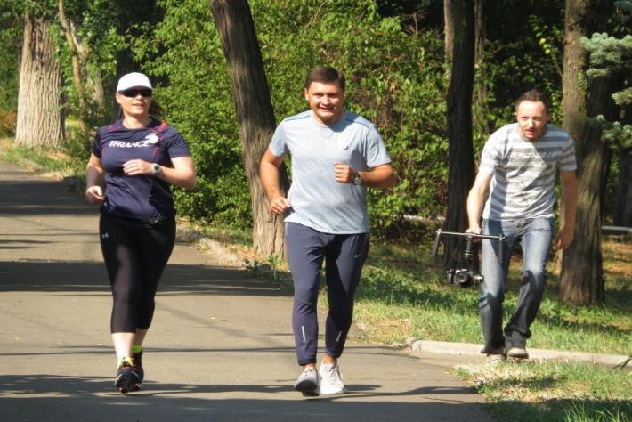
Mariupol - Athletic
A rally in honor of the Ukrainian-French partnership took place in Mariupol with the participation of Ambassador of France to Ukraine Isabel Dumont and Mayor of the city Vadim Boichenko.
The city authorities plan to send serious investments to the development of sports in Mariupol.
The representatives of French delegation, Mariupol athletes, deputies and residents took part in the morning race along the Azov Sea.
6

Slide 7
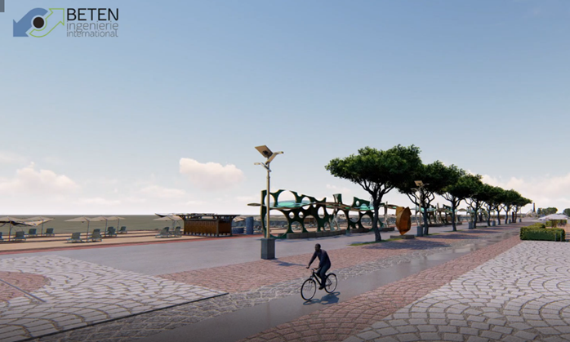
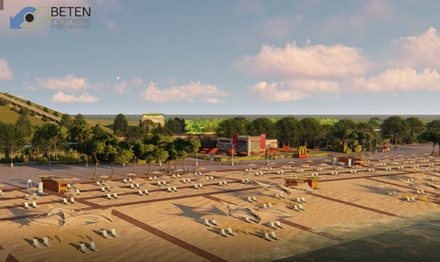
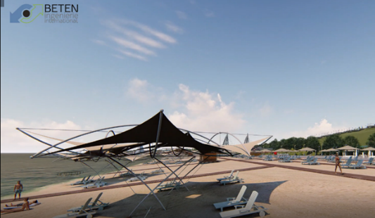
Reconstruction of the embankment of Mariupol
Mariupol embankment improvement project in the framework of decentralized cooperation with the cities of La Rochelle and Bordeaux
The visualization of one of the project options for the embankment improvement has been developed
7

Slide 8
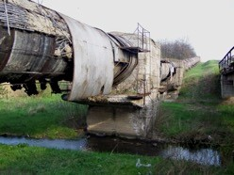
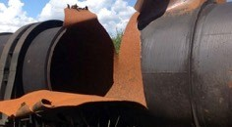
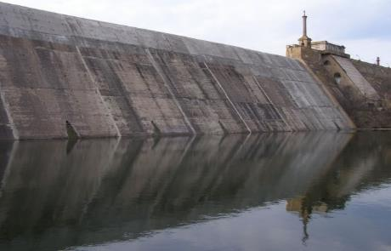
Water supply of Mariupol
Water supply of Mariupol is carried out from Severskiy Donets-Donbas channel and Staryi Krym Reservoir with the treatment of the source water at the filtering station of Company ‘Water Donbas’ public utility
Water scarcity
Decreasing of the quality of life of the population
Emergency condition of water supply networks
Increased water hardness
Severskiy Donets-Donbas channel
Deprecated infrastructure
There is a risk of undermining of the pipeline
40-60% of water loss in the channel
Staryi Krym Reservoir
The stocks of Staryi Krym reservoir are insufficient
Water rigidity exceeds the standard in 3-4 times
There is no possibility of full-time water supply
8

Slide 9
Water supply project of Mariupol
64
mln EUR
Signing of an agreement between France and Ukraine
Construction of filtering stations, renovation of outdated water supply systems
Obtaining an alternative source of water supply
2,8
mln EUR
Development of water supply. UNICEF support
Realization of ‘Social water’ project. Purchase of equipment and machinery.
Replacement of pipelines and reconstruction of a pumping station
2019 - construction of a pumping station and the creation of a Geoinformation system
27
mln EUR
Development of water supply. European Investment Bank
‘Municipal Infrastructure Development Program of Ukraine’ project
Reconstruction of 99 km of water supply systems of main category ‘C’ at 63 objects
9

Slide 10

Solid waste recycling
5,4
mln EUR
Solid waste recycling
Acquisition of waste sorting lines (manual sorting)
Productivity: 127 000 tons per year
      Cooperation with BETEN
      Construction of Solid Waste Landfill:
The first step is the second start-up
The second step is installation of a waste sorting line
Project development:
The improvements are effected, after that the expert report is received
10

Slide 11
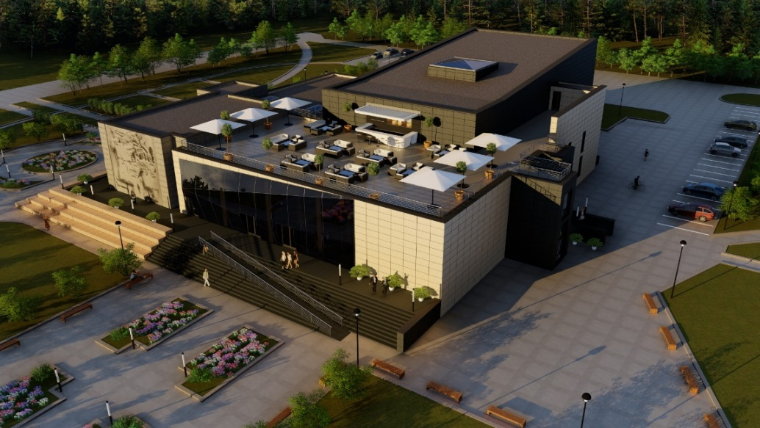
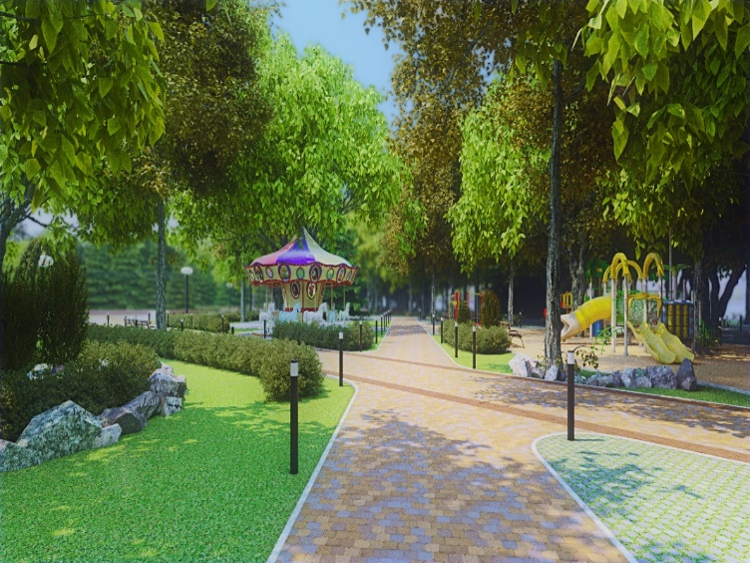
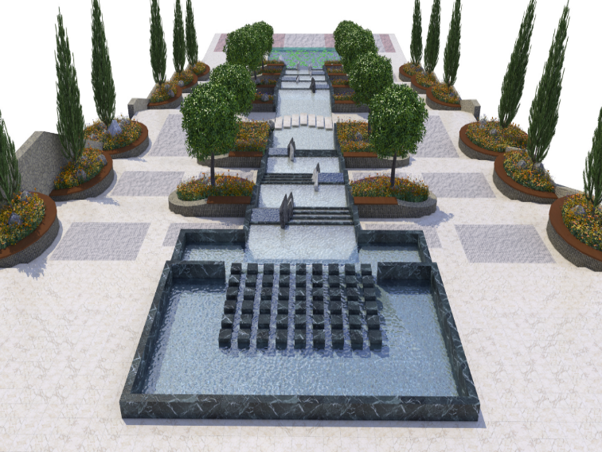
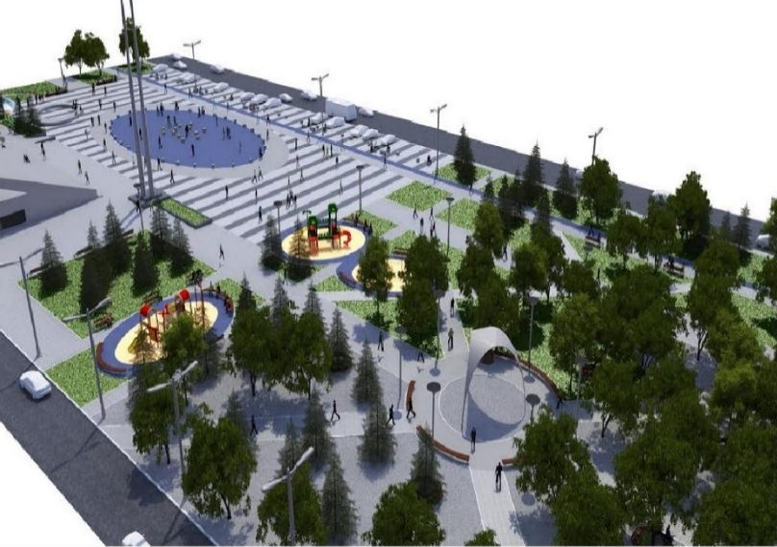
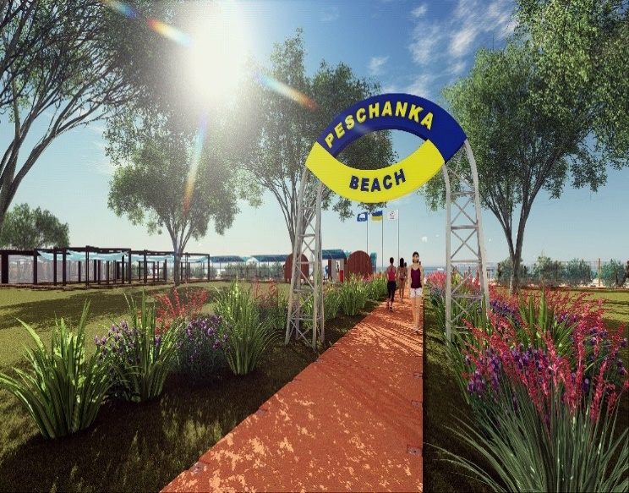
Mariupol- New opportunities
‘Multicenter’ social office and ‘Veselka’ park
Reconstruction of Gurova Park
Reconstruction of Freedom Square
Reconstruction of the beach

Slide 12
Thank you for your attention!

